Slide 1
Milestone 1
We deserve arrays • 10.11.2021

Slide 2
Iteration 1
To Dos
Qualitative evaluation
Personas & Scenarios
LoFi Paper Prototype
Usability evaluation

Slide 3
Qualitative Research
Context: Restaurants → has well-known and often similar procedure of tasks
Method: (Structured) Interviews
Participants: n = 8, age ∅ 38.8 (SD = 15.7) years
Topics: Technology usage, reasons to visit restaurants, in a group/alone,
description of typical visit, dis-/likes, interactions with staff etc.

Slide 4
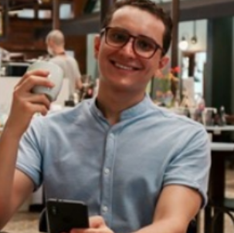


Personas & Scenarios
Jens the “Digital Introvert”
Goals:
eating in a clean environment and friendly considerate service
enjoying foods that he wouldn’t normally cook for himself
having as little interaction with the staff as possible
Topics covered:
Age, Family, Location, Character
Goals
Frustrations
Special Diet
Personality Traits
Biography
Scenario
Mary the “Golden Oldie”
Goals:
Reading the menu for a while and know about ingredients
possibility to talk to a waiter
have a memorable time and capture the moment with a selfie
Luna the “Social Butterfly”
Goals:
enjoying the company of her friends without being disturbed too much
use an app that allows for meal customization
have a memorable time and capture the moment with a selfie

Slide 5
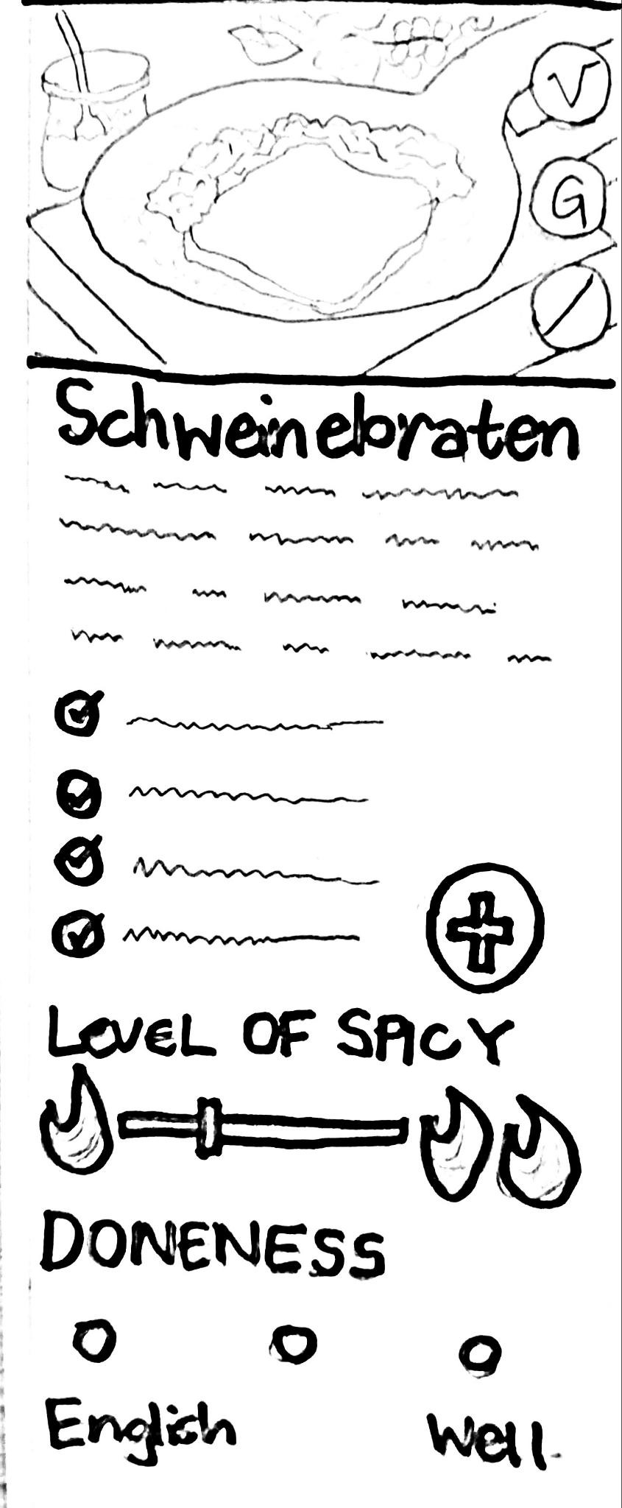
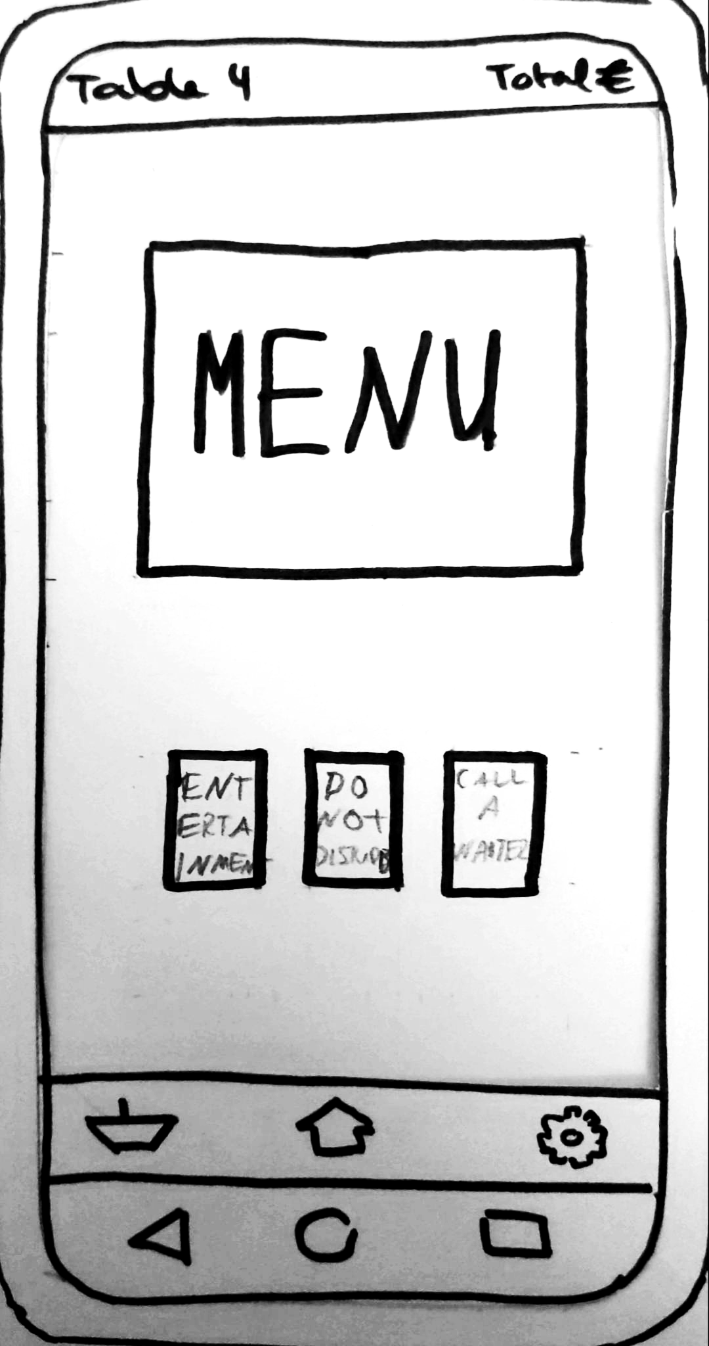
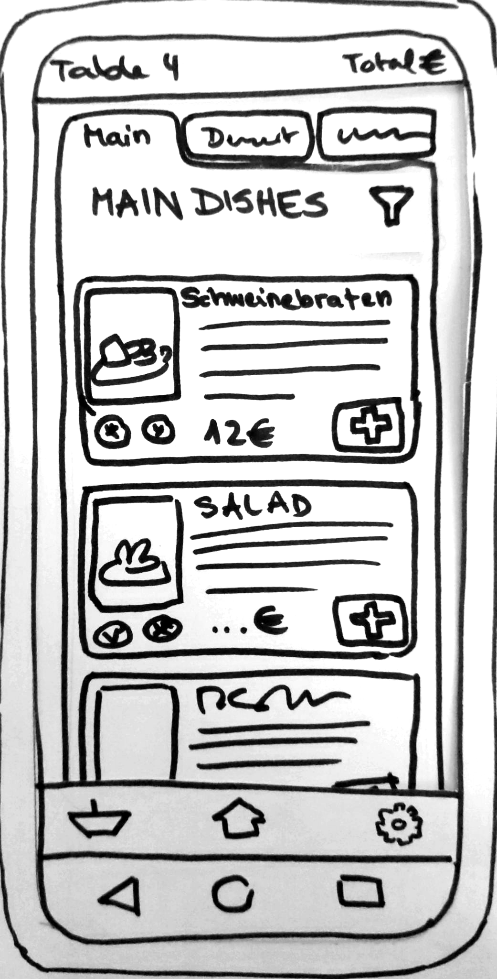
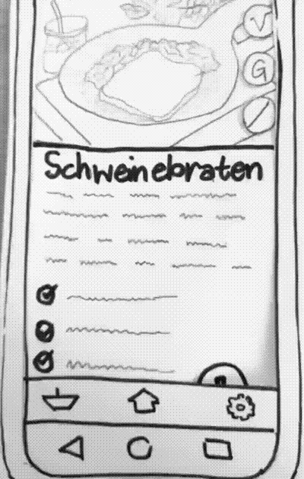
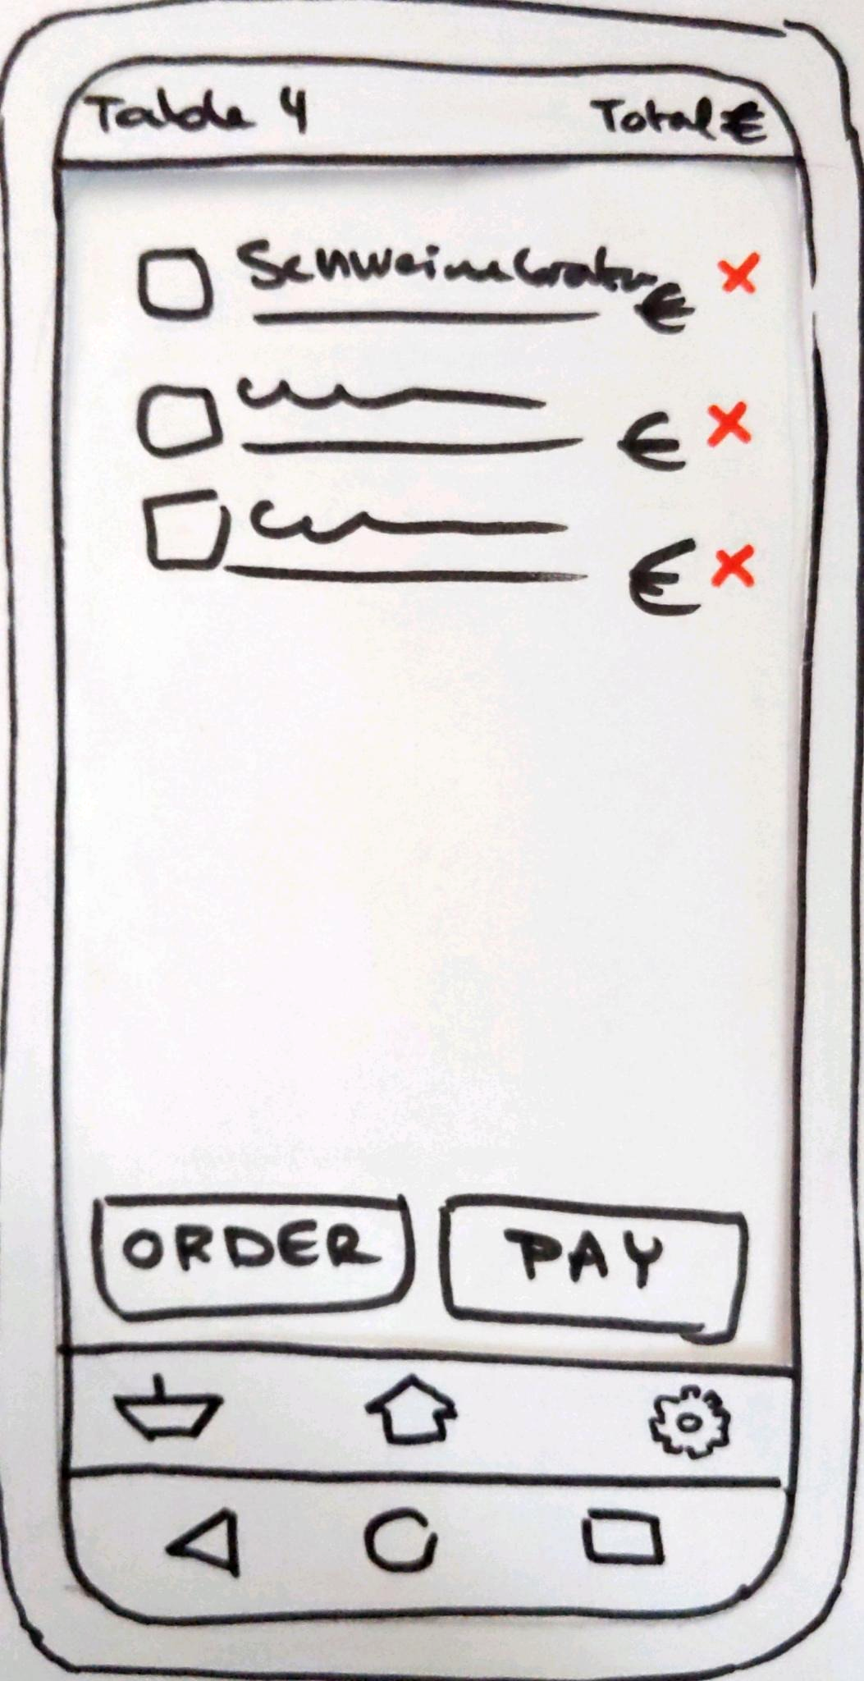
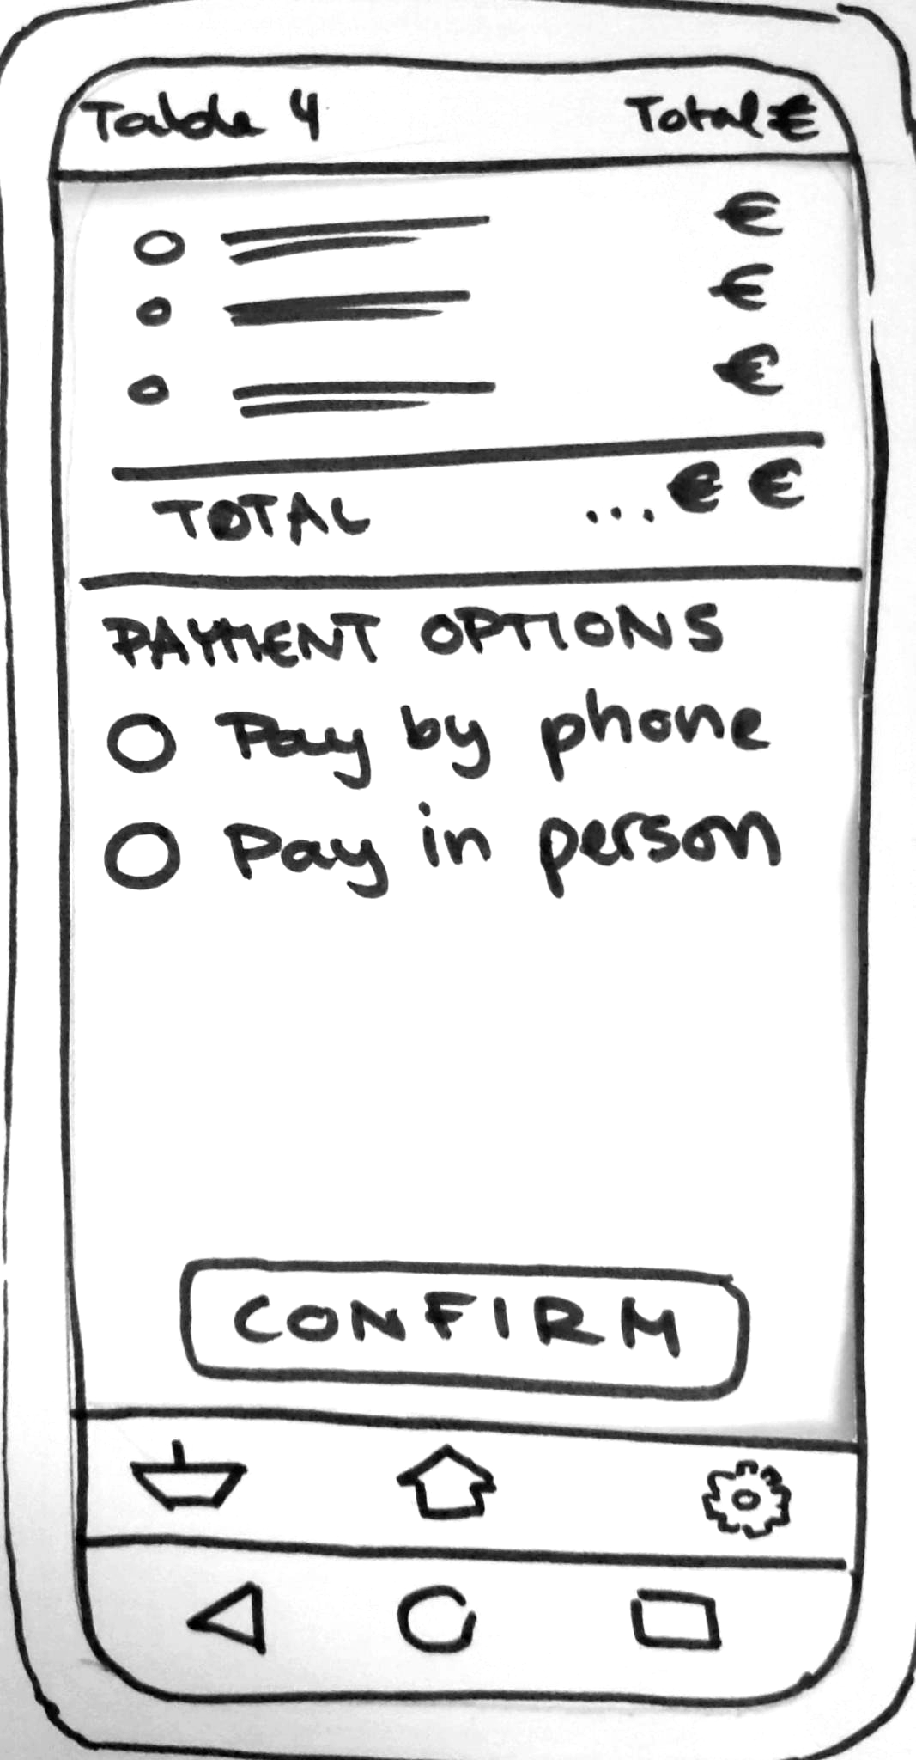
Paper Prototype

Slide 6
Usability Evaluation
Method: Task based experiment; Thinking Aloud
2 tasks → time; number of clicks; errors
Participants: n = 2
Results:
Main issues: “Add to order”-button; icons for vegan, vegetarian etc.
Improvements: Increase size and visibility for necessary elements

Slide 7
Discussion
Users prefer a simpler, minimalistic app, but are there still enough unique interactions to meet the requirements?
Order-Payment-Design ‒ Is there a more elegant solution here?

